Slide 1
The Danger in Disguise:
Social Media, Email, Etc ....
Vishing
Overpayment Scams
Fake Check Scam
Pharming
Ticket Scams
Advance Fee Fraud
Cybercrime
Phishing
Ransomware
Grandparent Scams
Spear Phishing
Charity Fraud
Romance Scams
Social Media (FB, TicToc, Insta, X Twitter)
Identity Theft
Investment Theft
Email Fraud
Scams
Technical Support Scams
Imposter Scams
Door-to-Door Scams
SMS Phishing
Pension Scams
Brent H Cooke SLVCC 2023

Slide 2
What Do All These Mean ?
How Do They Work ?
Scams can come in many different guises. So it’s important to know the warning signs to look out for and what to do if you have, or think that you have been targeted.
Scam Types
Protect Yourself From Scams
https://www.moneyhelper.org.uk/en/money-troubles/scams/types-of-scam
https://www.fca.org.uk/consumers/protect-yourself-scams

Slide 3
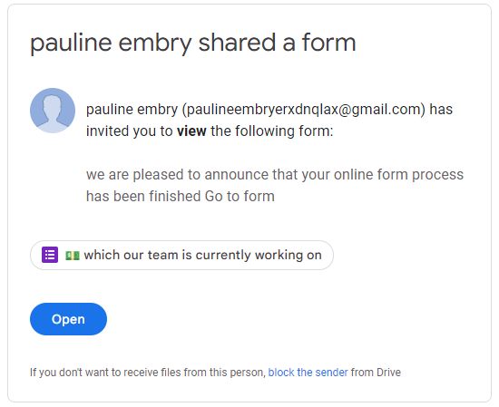
Real Life Examples
Email on Yahoo Mail - looks to be from Google:
Subject: Fwd: Form shared with you: “which our team is currently working on"

Slide 4
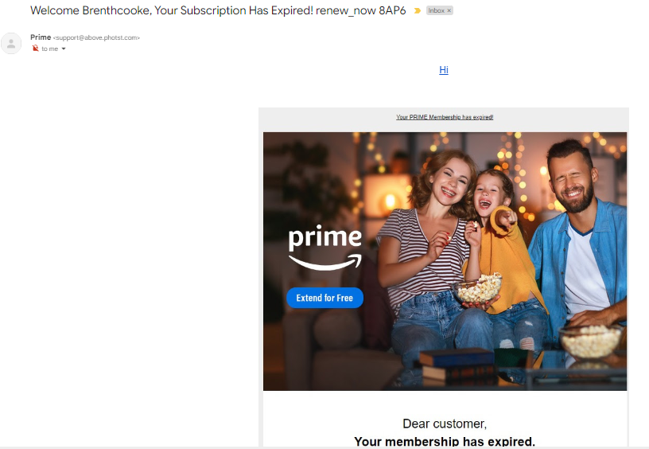
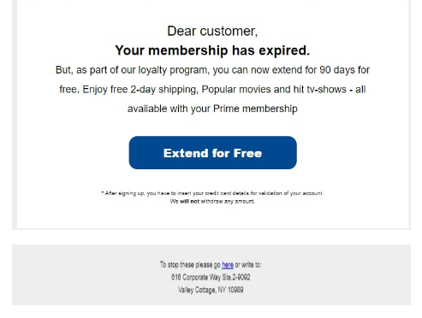
Real Life Examples
http://above.photst.com/fr=6hiOObn6ix3x/%7COxbDn-hK%7ChtPn%7C/NDjnbstXh6i3kRcPC6Dn219LGs9NIK0%7CA6D/n%7CDB2BOjOnkRuXkRfMn%7C%7C6OK
Email on Gmail Acct - looks to be from Amazon Prime (purchases and tv)
Subject: Your Subscription Has Expired
<support@above.photst.com>

Slide 5
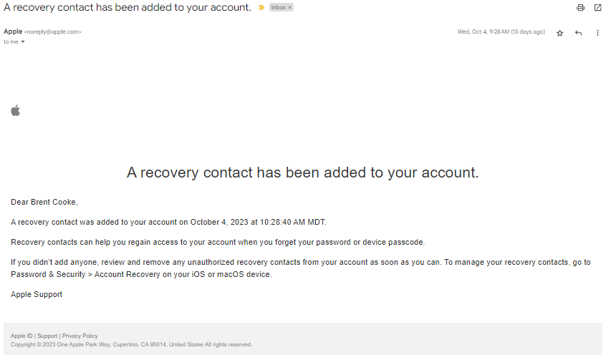
Real Life Examples
Email on Gmail Acct - looks to be from Apple about Security
Subject: A recovery contract has been added to your account.
Did not ask me to CLICK ON anything. They
Gave me directions to sign onto to my acct
Independently (not through a lick).

Slide 6
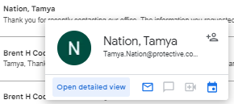
Real Life Examples
Email on Gmail Acct - looks to be something legal (?)
Subject: W-9 FORM.
Reply ->

Slide 7
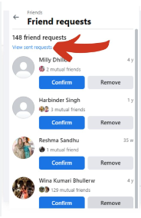
Real Life Examples
Facebook Friend Request - Oh WOW !!!! I havent spoken to xxxxxx in quite a while
Before You Click “Confirm” ……..
Is there a picture that you can look at?
Select the picture and look at the profile. Does it look legit? Hometown? History?
Look at the pictures in the profile – valid?
When was the account created? Within 2 months – 2 years?
Consider calling or emailing them to ask if they sent the request.
Aren’t I already friends with xxxxxx? (check your list)
After You Click “Confirm” …….. (without fully checking)
Do not give out personal information.
Ask maybe how they are doing along with some random incorrect question:
Sorry to hear about MAX – he was a great dog – are you planning to get another?
Or a fictitious spouse: Gosh, I haven’t seen you and Dianne for like 4 years now – how’s she doing?
They will either avoid the question or respond suspiciously.
Unfriend Them !!!

Slide 8
Why is Avast showing up in my email? If you use an email client (such as Microsoft Outlook or Mozilla Thunderbird), Avast Antivirus may include a Virus-free message (previously an email signature) at the bottom of your outgoing emails to let your recipients know that the email has been scanned for malware. This setting is enabled by default.
So even when you believe you’re protected, the scammers are still trying to trick you into doubting, and then taking action.
“Always” go back to your approved source (bank app, web site, device app) to check. “Never” use a link that someone has sent you.
What is the fake Avast warning?
What is the “Avast Your PC Is Infected With 5 Viruses” pop-up? The “Avast Your PC Is Infected With 5 Viruses” alert is a browser-based scam that tries to trick you into thinking that a Avast scan has detected viruses on your device and you need to renew your antivirus subscription to remove them. Feb 19, 2023

Slide 9
Real Life Examples
Other Scams here in the PHX area – just this year.
Bank Funds Scam: Bank employee called to tell her that her savings acct had been hacked into and $$s removed via a fraudulent charge. Helped her through moving the remaining $$s to a “temporary holding acct”. 24 hr hold till the account was accessible again.
Result: All $$s went missing and no recourse to retrieve as the “temp” acct was fictitious.
Should Have Done: ???
Grandparent Late Night Call: Grandchild called. Person said “Gramma”? Grandparent said a name, and it just went from there. Caller had them hooked and kept them on the phone to xfer funds. Middle of the night – they weren’t thinking straight.
Result: Large sum of money lost .
Should Have Done: ???
Land Title Scam: Fraudsters are submitting “change of ownership” forms for land and residences at the titles office.
Callers Can Reproduce “ANY” Phone Number: If you have numbers in your contact list (your bank, etc) typically 8xx numbers. Scammers will use these. So even though your contact list says “Wells Fargo Support” (contact list) …… It does not necessarily mean it really is them.
Should Do ???

Slide 10
Spot The Warning Signs
Scams can be (WILL BE) difficult to spot. Fraudsters can be convincing and knowledgeable, with websites and materials that look identical to the real thing.
If you’ve been contacted unexpectedly, or are suspicious about a call or text message, make sure you stop and check the warnings signs.
Is it unexpected? Scammers often call out of the blue. They may also try and contact you via email, text, post, social media, or even in person.
Do you feel pressured to act quickly? Scammers might offer you a bonus or discount if you invest quickly, or they may say the opportunity is only available for a short time.
Does the offer sound too good to be true? Fraudsters often promise tempting rewards, such as high returns on an investment.
Is the offer exclusively for you? Scammers might claim that you’ve been specially chosen for an investment opportunity, and it should be kept a secret.
Are they trying to flatter you? Scammers often try to build a friendship with you to put you at ease.
Are you feeling worried or excited? Fraudsters may try to influence your emotions to get you to act.
Are they speaking with authority? Scammers might claim that they’re authorized and often appear knowledgeable about financial products.
If you answered ‘yes’ to any of these questions, or you’re unsure if a contact is genuine, follow the steps to protect yourself.

Slide 11
How To Protect Yourself
Do:
Treat all unexpected calls, emails and text messages with caution. Don’t assume they’re genuine, even if the person knows some basic information about you.
Hang up on calls and ignore messages if you feel pressured to act quickly. A genuine bank or business won’t mind waiting if you want time to think .
Check your bank account and credit card statements regularly.
Consider getting independent financial advice or guidance before a big financial decision.
Check overseas regulators if you’re dealing with an overseas firm.
Install Virus Protection on your computer devices.
Keep your electronic devices fully updated (OS updates, Virus Protection).
Don’t:
Give out your bank account or credit card details unless you’re certain who you’re dealing with.
Share your passwords with anyone (including your social media passwords).
Give access to your device by downloading software or an app from a source you don’t trust. Scammers may be able to take control of your device and access your bank account.
YOU are the first line of defense in protecting your assets

Slide 12
Stay Informed
Phishing Threats in 2023
https://it.ucsf.edu/new-phishing-threats
Phishing Threats (by state) in 2023
https://www.forbes.com/advisor/business/phishing-statistics/
Social Media Phishing – The 2023 Cybersecurity Threat
https://www.infosecurity-magazine.com/next-gen-infosec/social-media-phishing-threat/
YOU are the first line of defense in protecting your assets

