Slide 1
Mobile Phone, Tablet, ipad & windows Organization
Treat Your devices like a file cabinet

Slide 2
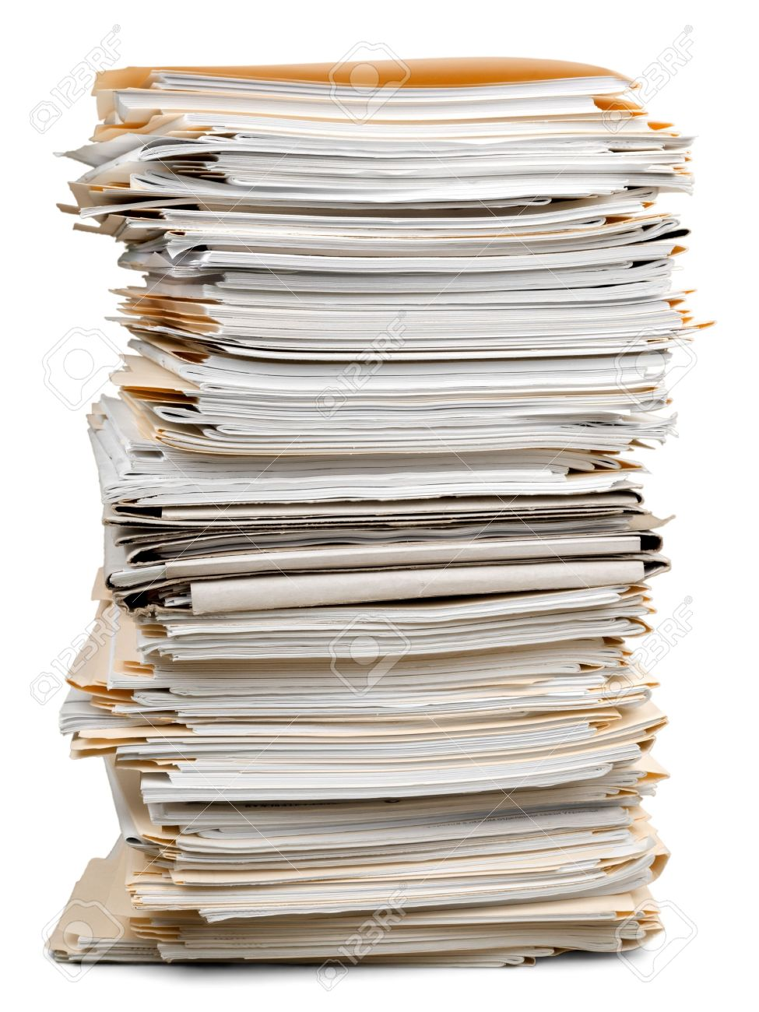
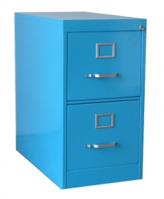
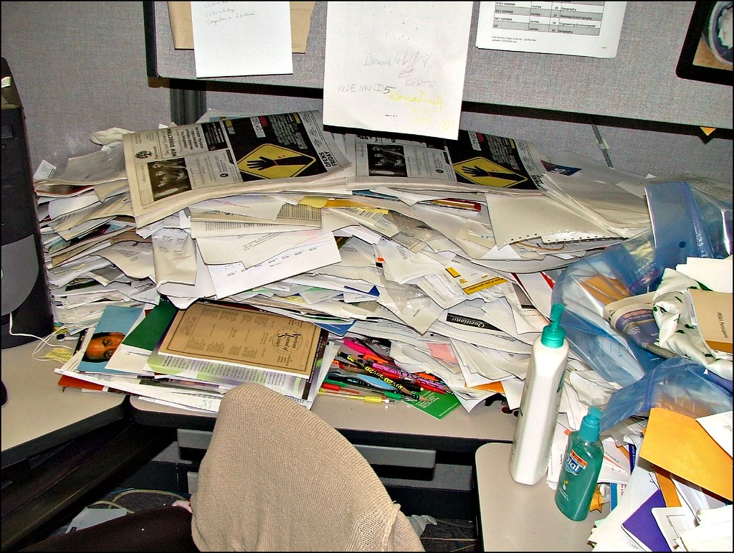
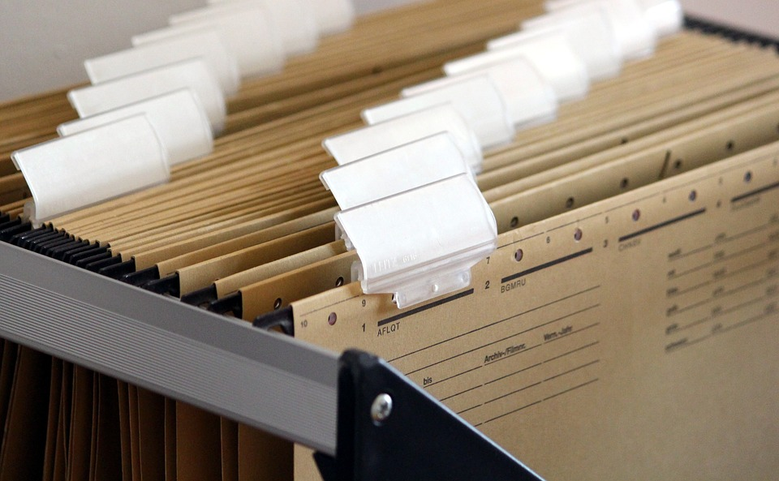
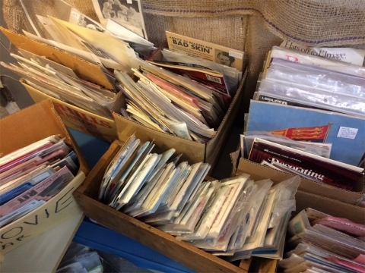
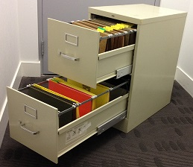
This? -or- This?
This Photo by Unknown Author is licensed under CC BY-ND

Slide 3
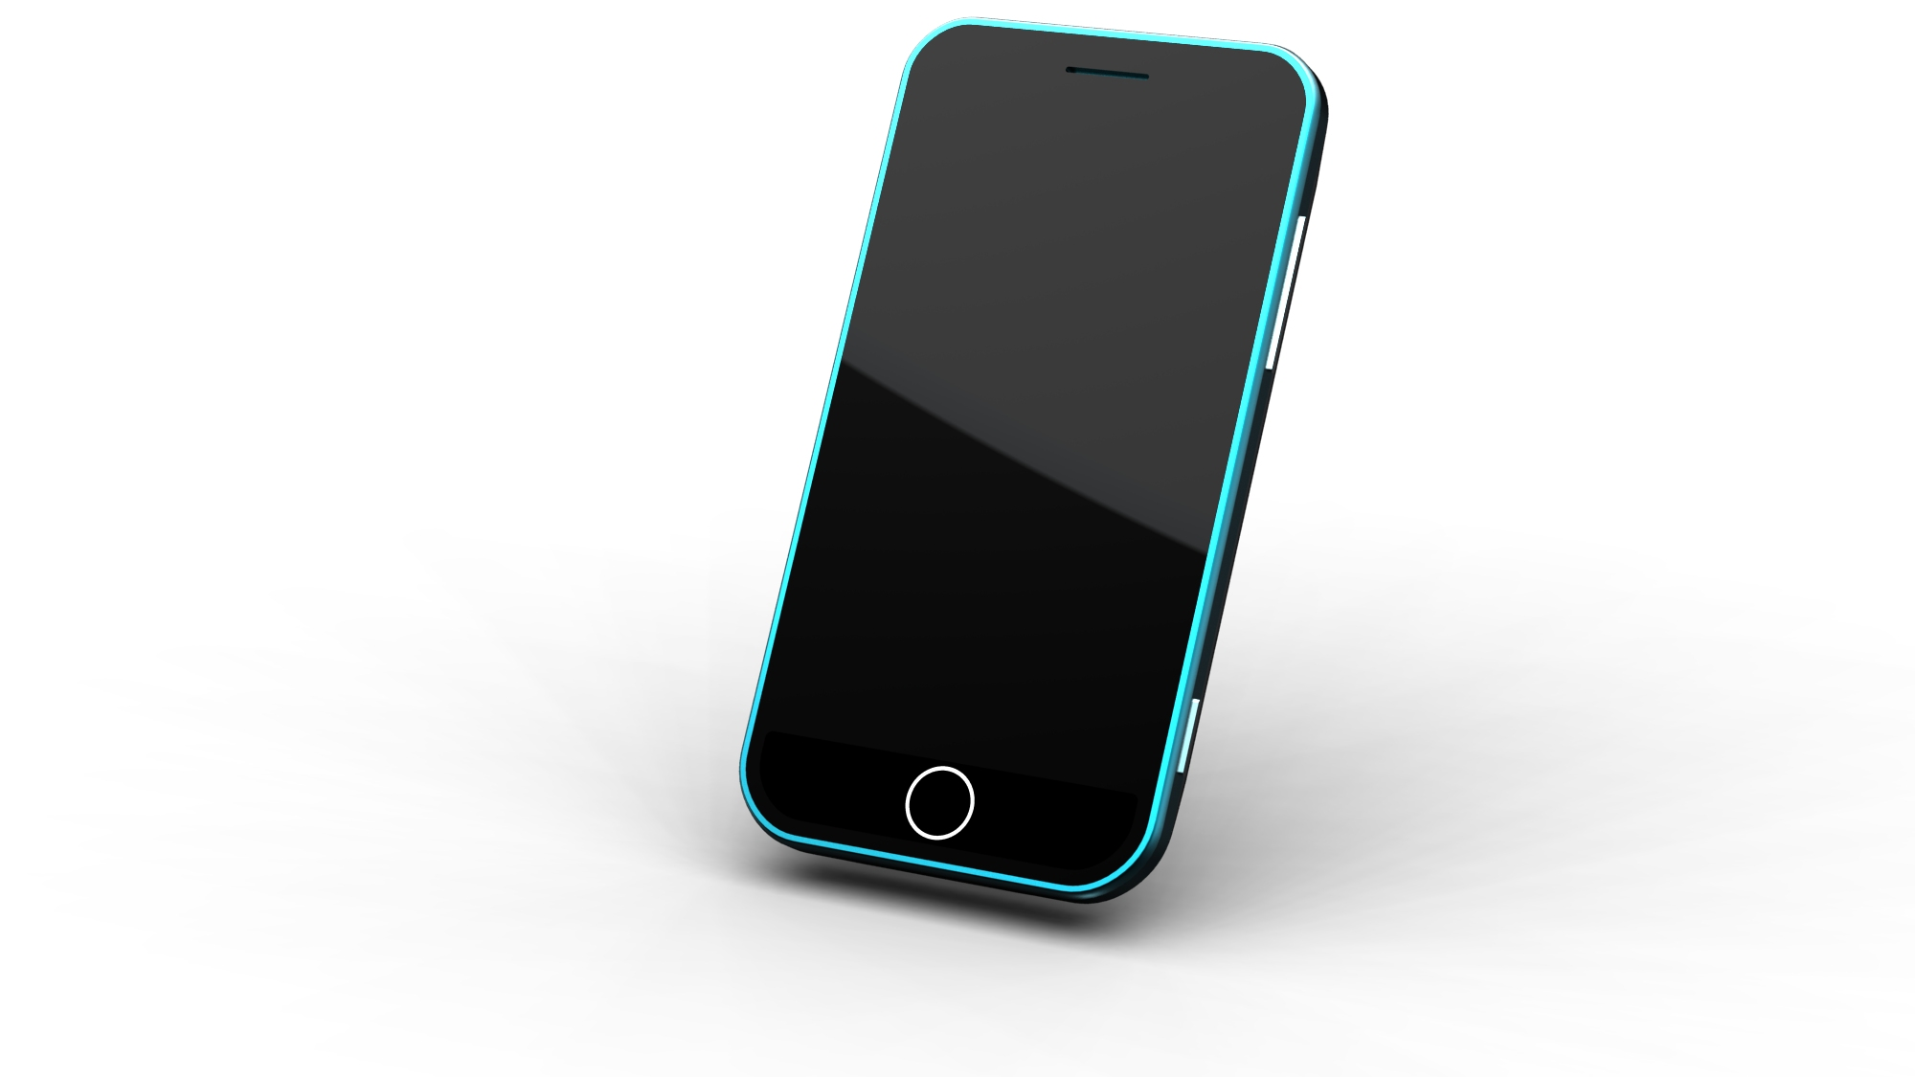
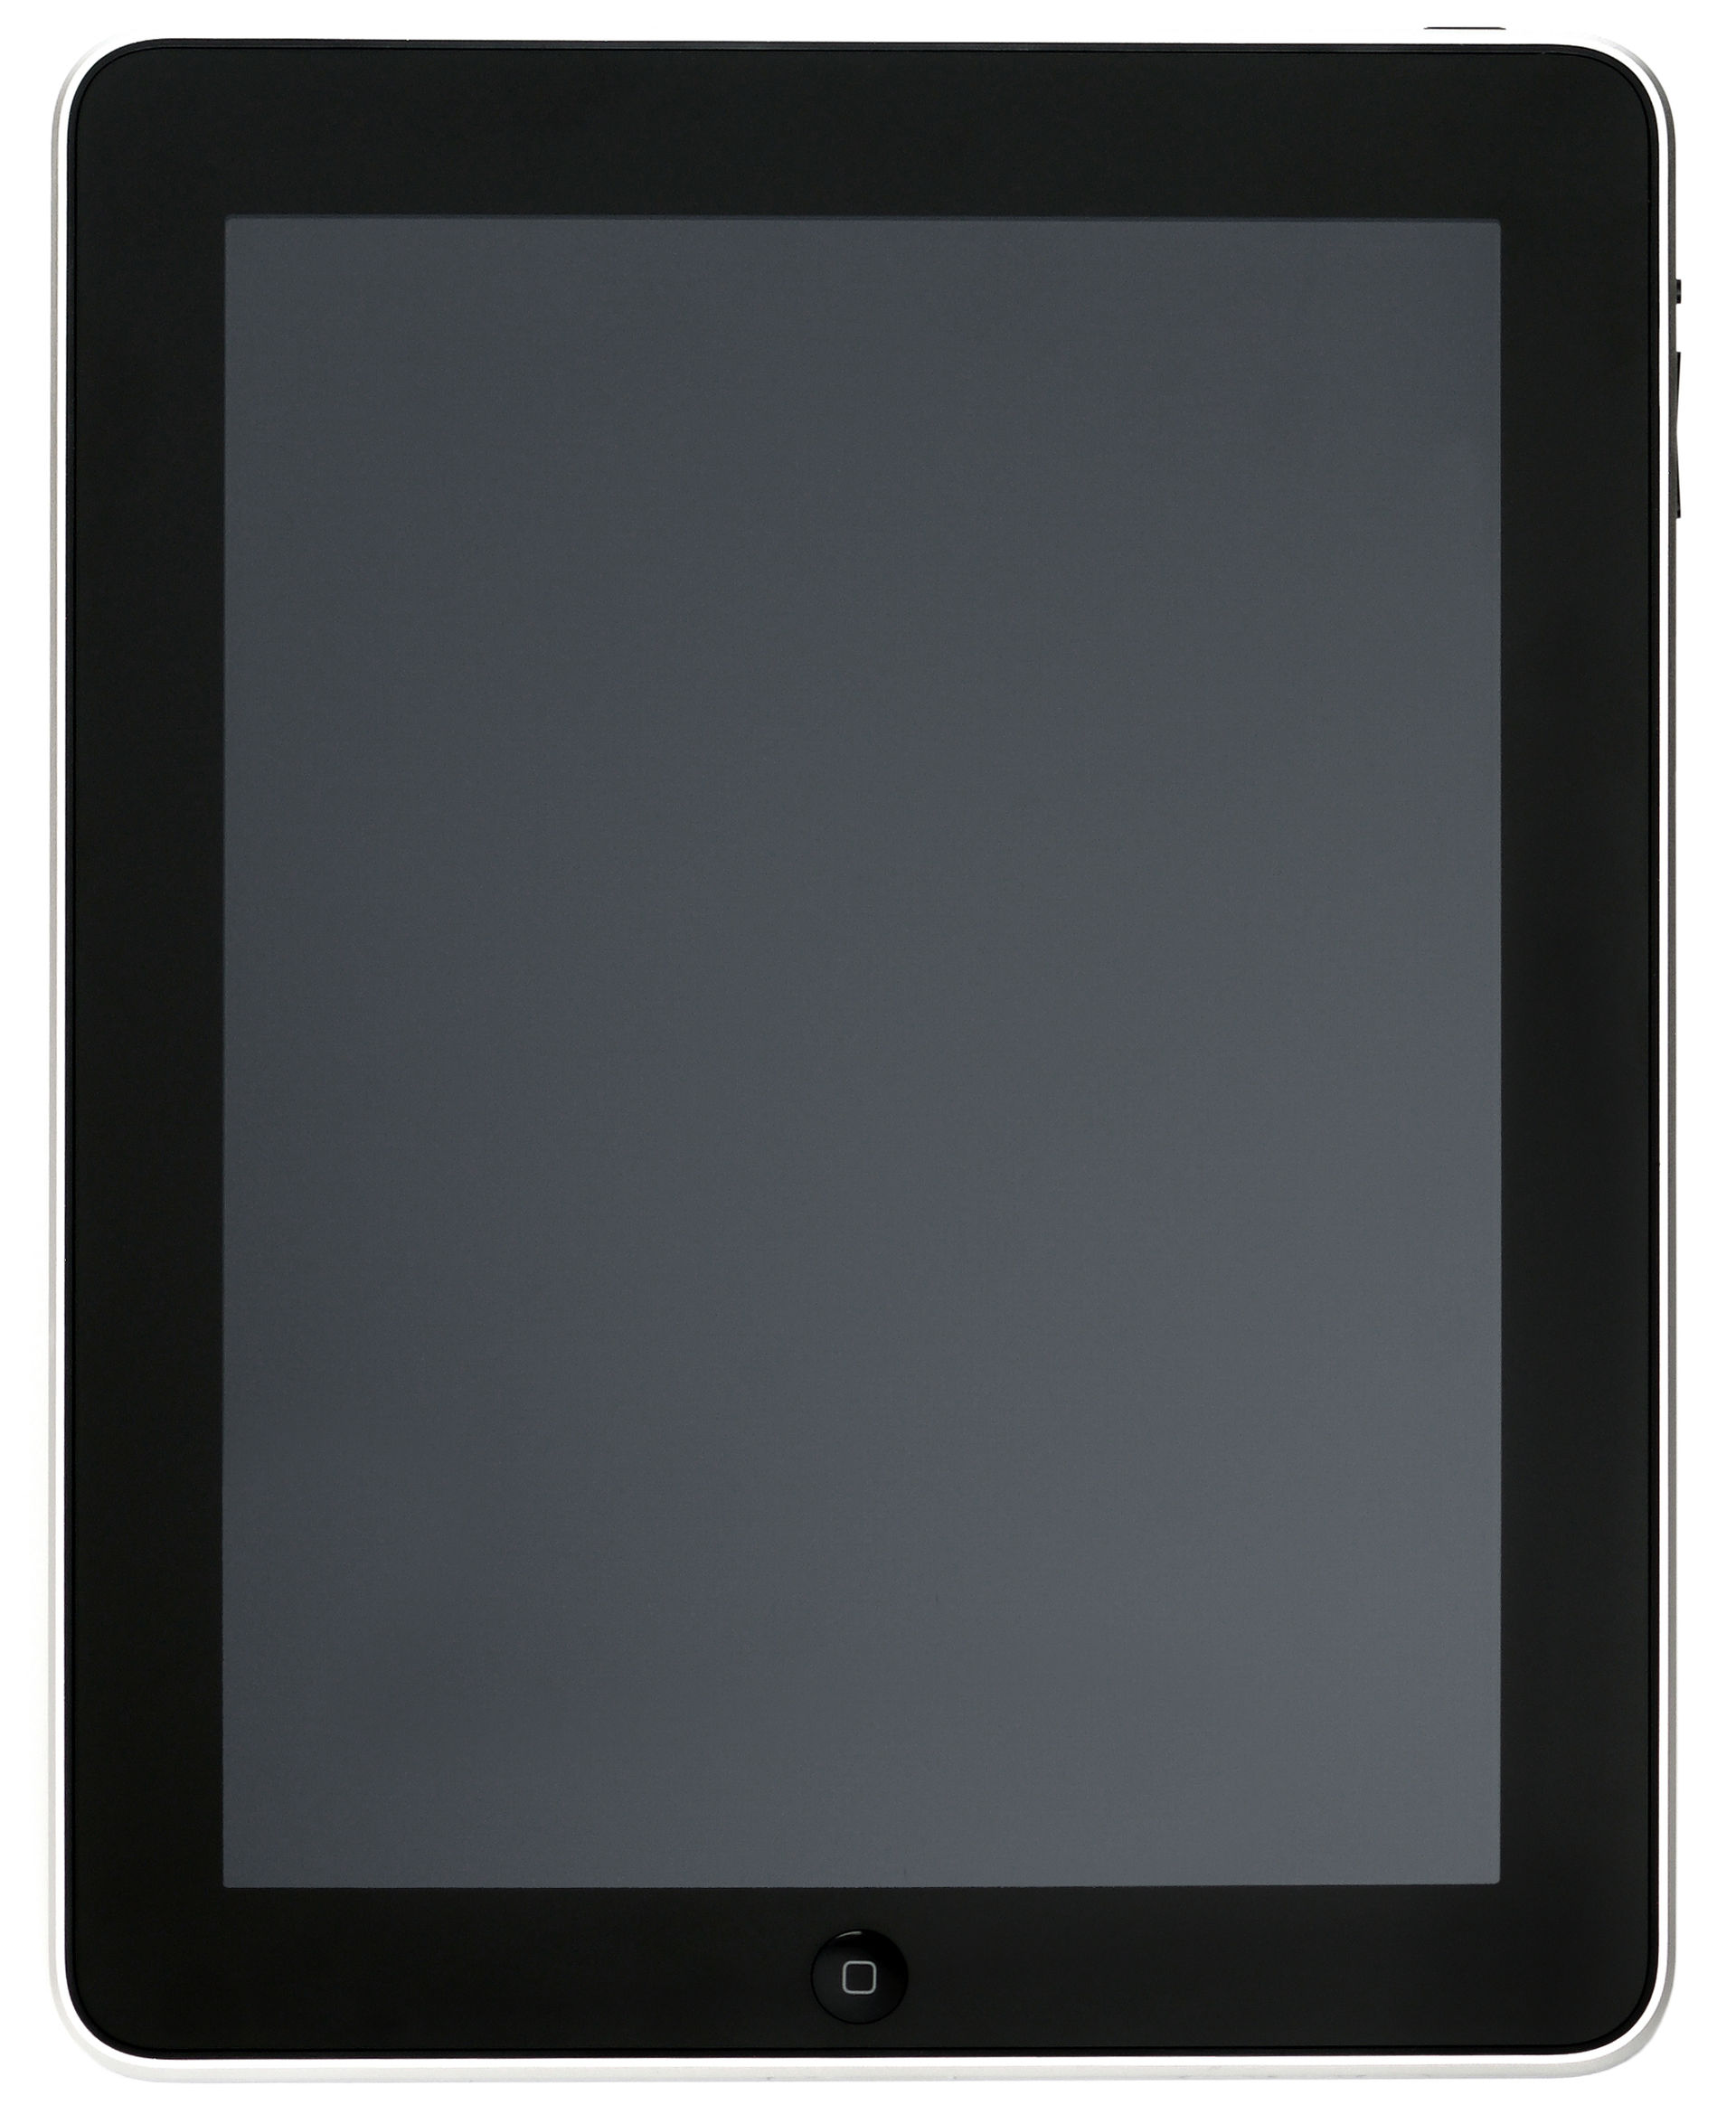
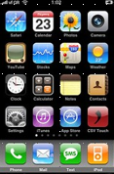
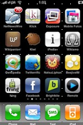
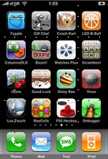
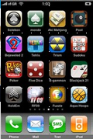
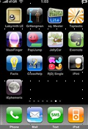
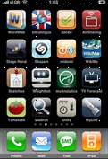
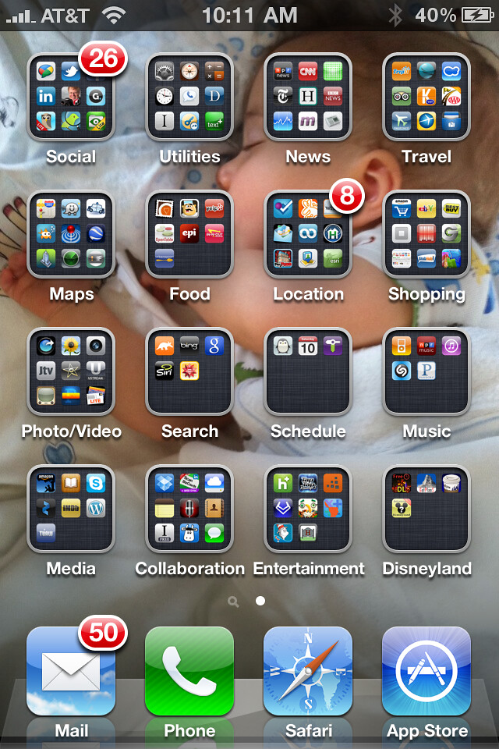
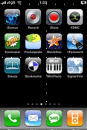
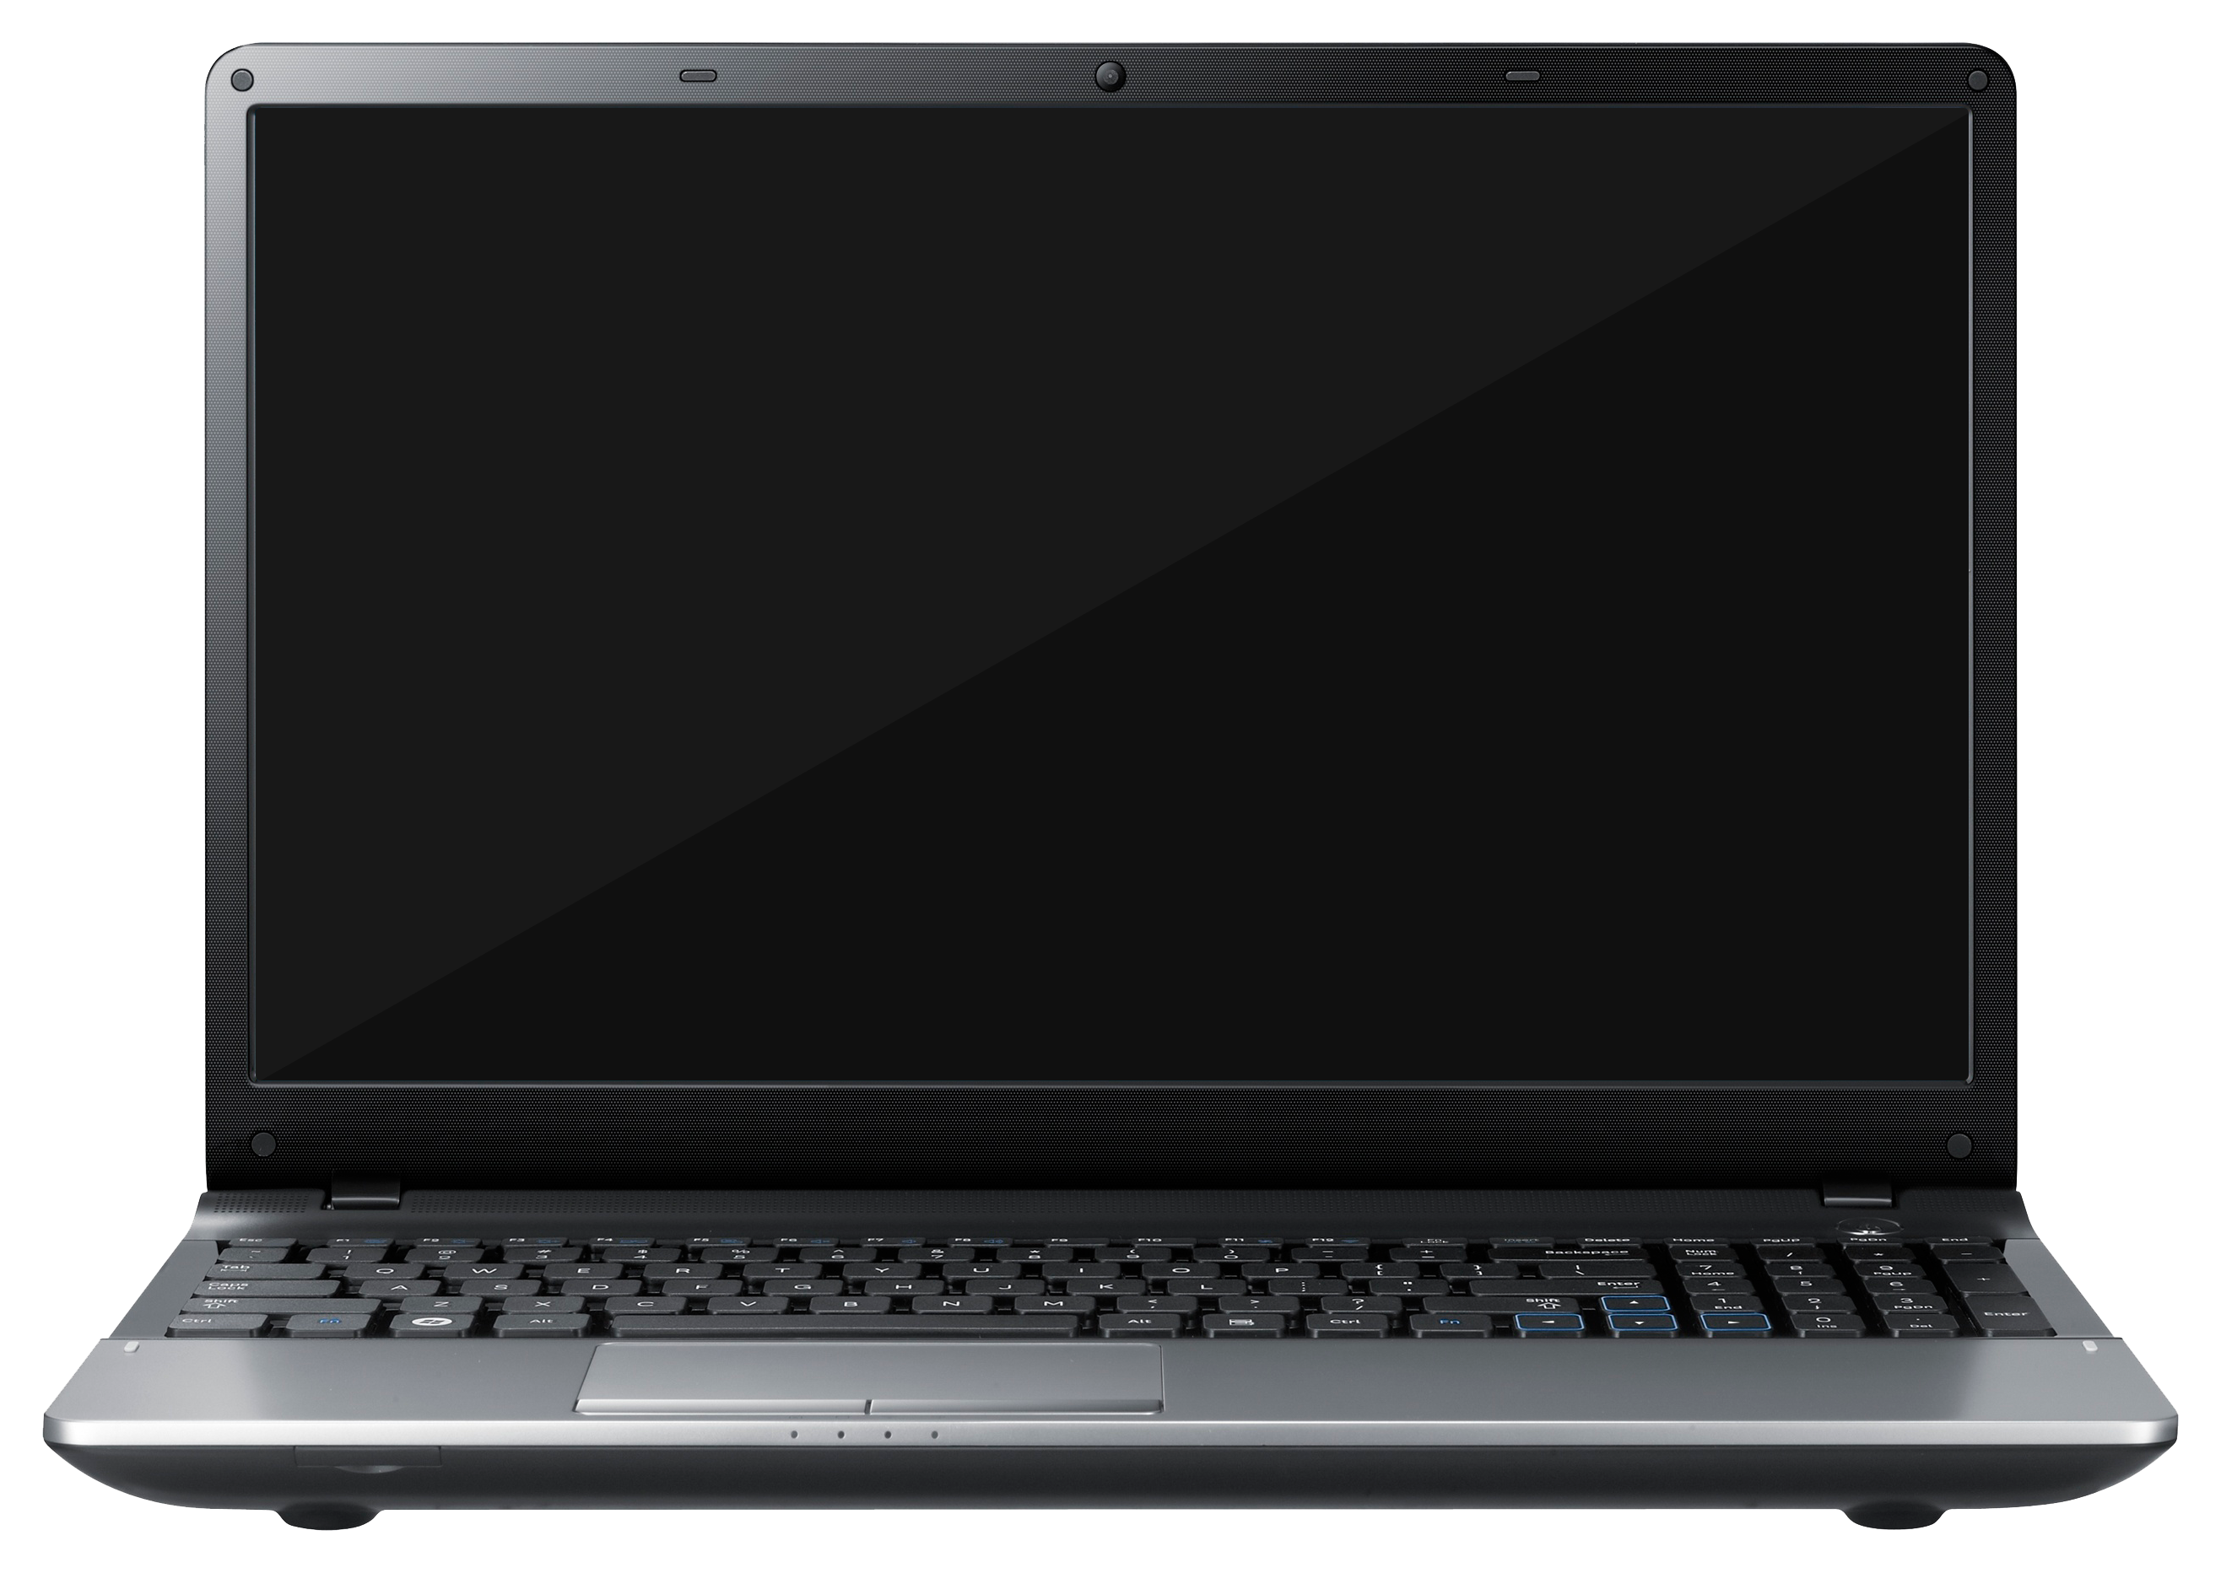
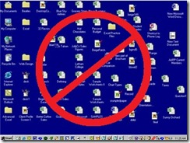
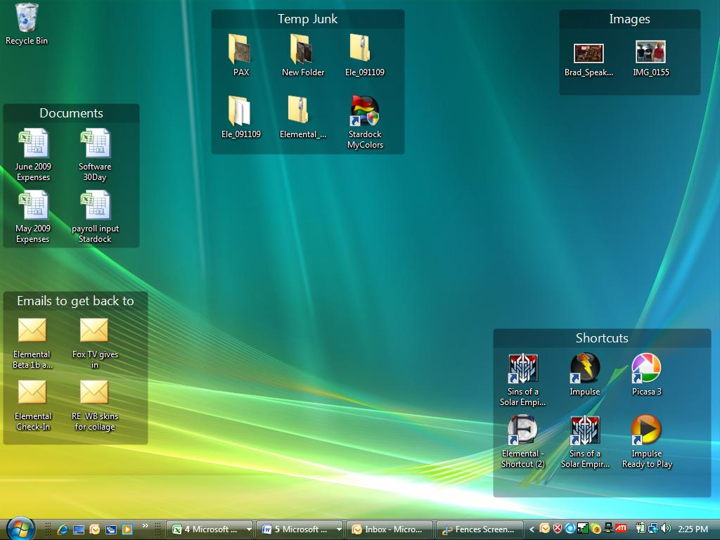

Slide 4
Even your trusted publisher
READER’S DIGEST – SAYS …………..
“Using these pro strategies to organize your home screen could be just the ticket to working faster and smarter.”
https://www.rd.com/article/how-to-organize-computer-desktop/
https://www.popsci.com/clean-up-computer-desktop/

Slide 5
Search ….
Google Search : “readers digest computer organization”
Google Search : “popular science cleanup computer”

Slide 6
SO what are these strategies (Tips) ??
Make shortcuts to your files
The golden rule of working on a computer desktop? Never save files directly to the desktop. Instead, be sure to first save files to your “My Documents” folder on your hard drive.
Or (brent) …. Create desktop folder(s) and drag your desktop files to it.
Sort your files into folders (group your apps into categories)
Organize your folders (alphabetic sequencing of your folders/categories)
Color-code your folders
Don’t let it get cluttered (w10 – icon management: right click on home screen)
Putting these tips into practice ……….

Slide 7
Create a list of starting categories meaningful to you
Arizona
Audio visual
Browsers
Entertainment
finances
Games
Google
Health
Home
misc
Music
My recipes
Navigation
Office apps
Personal
Security
Shopping
Social
Sports
taxes
Travel
Utilities
Video chat
Weather
Don’t create a “banking” category – put banks under a different header

Slide 8
How do I create a folder or category
Windows home screen - Right click your mouse
Select “new”
Select “folder”
New Folder gets created
Right click “new folder”
Select “rename”
Rename your folder and press return –or- enter
MAC OS
Ctrl+click and choose New Folder.
Select an app and press it until it begins to jiggle
Drag the app over top of another app and release pressure
The apps will be merged into a group
Select the group and press it until the group jiggles
Release pressure and you will be able to rename the group (use capital letters so the group name is easier to read)

Slide 9
Helpful smart phone/ipad/tablet apps
Key Ring - Take pictures of those retail cards you have (Fry’s, CVS, Kroger, Lowes, etc)
Store pics of my auto license plates, vehicle insurance cars, etc.
OOKLA Speed Test - Test the speed of your network or your connection. (up/down).
Bubble Level - Check the level/grade of something (no need for a physical level).
Files/FileMaster/FileManager - To look for files you downloaded to your tablet/iPad/iPhone/etc
Google Maps/Waze - Navigation
SkyView Lite - Look at the sky and identify stars, constellations, planets.
Compass - Direction finder.
AZ Family - Channel 3 news app.
AirVisual - Air quality for your area.
MesaNow - Mesa Govt related links (events, utility info, recycling, govt contacts).
OurGroceries - Create shopping lists and share (use the same user id and works great).
Wonderground/The Weather Channel/Weather
- Customize your local weather. Include additional locations.
Memory&Disk Scanner - To clear app memory and speed up your smart phone / tablet / ipad.
Whatever App you download 1) review the available screens they offer, 2) identify app cost, 3) check user reviews, 4) don’t give
personal information for a free app other than an email/password or username/password.

Slide 10
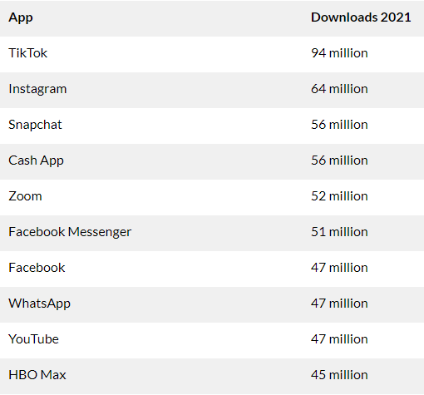
Most popular apps (USA)
App` | Downloads 2022
Tik Tok | 99 million ( ^+)
Instagram | 72 million ( ^+)
Cash App | 64 million ( ^+)
WhatsApp | 63 million ( ^+)
Snapchat | 54 million ( v )
Subway Surfers * S | 51.4 million (new)
Roblox * + | 50.9 million (new)
Amazon | 47 million (new)
Facebook Messenger | 46.3 million ( v )
Facebook | 45.5 million ( v )

Slide 11
What kind Of apps
For the most part, people want to be connected.
7 Apps in 2021 - personal communication
6 Apps in 2022 - personal communication
There are 2.87 million apps available for download on the Google Play Store. 21% of Millennials open an app 50+ times per day. 49% of people open an app 11+ times each day. 70% of all US digital media time comes from mobile apps.

Slide 12
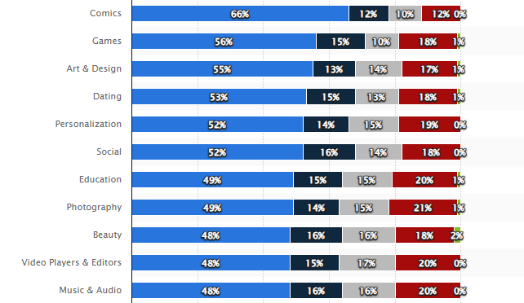
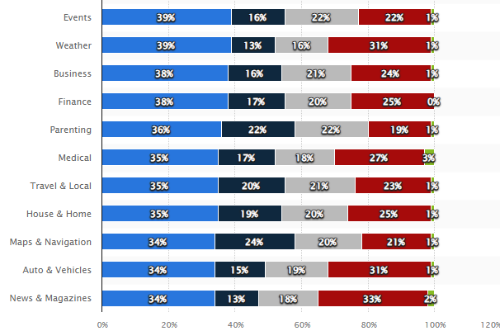
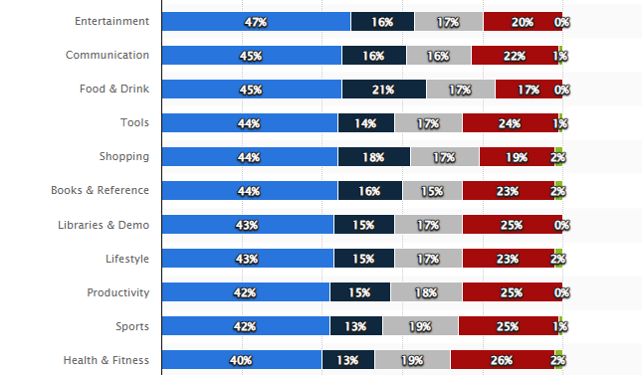
What age groups (google Play store)

Slide 13
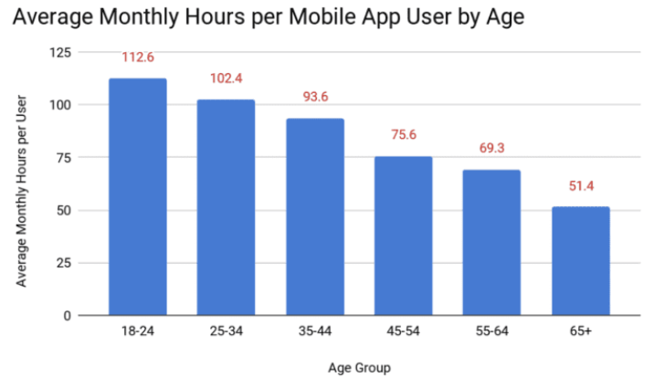
Hours Used by Age group

